Slide 1
Data Development Utilizing Database Design and SQL
Day 9

Slide 2
Getting Started with MySQL
If you do not have MySQL installed on your workstation, download and install it from http://dev.mysql.com/downloads/
You may also consider downloading and installing MySQL Workbench from https://dev.mysql.com/downloads/workbench/

Slide 3
Getting Started with MySQL
The MySQL Monitor is a command-line program for manipulating MySQL databases
Connect to the MySQL server using a command-line connect
Commands are entered at the mysql-> command prompt in the console window
Enter the following command:
mysql –h host –u user –p
Two accounts are created:
Anonymous user account allows login without specifying a username or password
root account (the primary administrative account for MySQL) is created without a password
mysql –u root
Log out with the exit or quit commands

Slide 4
Logging in to MySQL
$ mysql –h php_db -u student -p[ENTER]
Enter password: **********[ENTER]
Welcome to the MySQL monitor. Commands end with ; or \g.
Your MySQL connection id is 6611 to server version: 4.1.9-nt
Type 'help;' or '\h' for help. Type '\c' to clear the buffer.
mysql>
Use the up and down arrow keys on the keyboard to scroll through previously entered commands

Slide 5
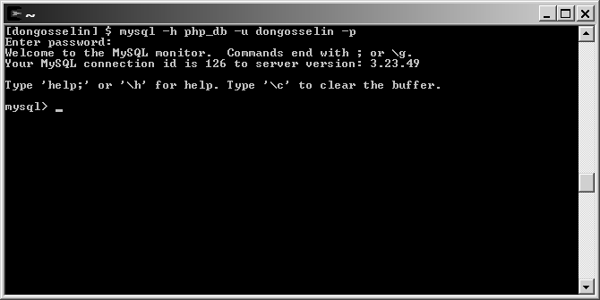
Logging in to MySQL
Figure 7-6 MySQL Monitor on a Windows platform

Slide 6
Working with the MySQL Monitor
At the mysql> command prompt terminate the command with a semicolon
mysql> SELECT * FROM inventory;
Without a semicolon, the MySQL Monitor enters a multiple-line command and changes the prompt to ->
mysql> SELECT * FROM inventory
->
The SQL keywords entered in the MySQL Monitor are not case sensitive

Slide 7
Understanding MySQL Identifiers
An alias is an alternate name used to refer to a table or field in SQL statements
The case sensitivity of database and table identifiers depends on the operating system
Not case sensitive on Windows platforms
Case sensitive on UNIX/Linux systems
MySQL stores each database in a directory of the same name as the database identifier
Field and index identifiers are case insensitive on all platforms

Slide 8
Understanding MySQL Identifiers
Identifiers that must be quoted using the backtick, or single quote, character (`)are
An identifier that includes any character except standard alphanumeric characters, underscores (_) or dollar signs ($)
Any identifier that contains one or more space characters
An identifier that is a reserved word in MySQL
An identifier made entirely of numeric digits
An identifier that contains a backtick character
Ideally, identifiers should not contain any special characters.

Slide 9
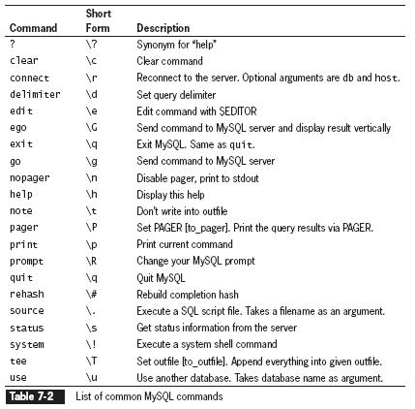
Getting Help with MySQL Commands

Slide 10
Creating Databases
Use the CREATE DATABASE statement to create a new database:
mysql> CREATE DATABASE tal_distributors;[ENTER]
To use a new database, select it by executing the USE DATABASE statement

Slide 11
Selecting a Database
Use the DATABASE() function to return the name of the currently active database
mysql> SELECT DATABASE();[ENTER]
View the available databases using the SHOW DATABASES statement
mysql> SHOW databases;[ENTER]
Use the DROP DATABASE statement to remove all tables and delete a database
mysql> DROP DATABASE database;

Slide 12
Defining Database Tables
Data types that are assigned to fields determine how much storage space the computer allocates for the data in the database
Choose the smallest data type possible for each field

Slide 13
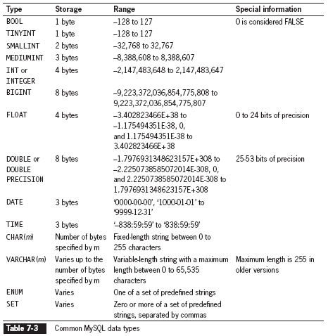
Defining Database Tables
Compare the MySQL data types with Oracle data types. What are the differences?

Slide 14
Creating Tables
Use the CREATE TABLE statement to create a new table and define the column names and data types for each column
mysql> CREATE TABLE REP
(REP_NUM CHAR(2), LAST_NAME VARCHAR(15),
FIRST_NAME VARCHAR(15));[ENTER]
Use the DESCRIBE table_name statement to view the structure of the table
Reference the MySQL CREATE TABLE documentation at http://dev.mysql.com/doc/refman/5.7/en/create-table.html

Slide 15
Changing Table Field Names
Use the ALTER TABLE to change the name of an existing field in a table using the following syntax
ALTER TABLE table_name ADD [COLUMN] (column_name column_type [, column_name column_type ...]);
Reference the MySQL ALTER TABLE documentation at http://dev.mysql.com/doc/refman/5.7/en/alter-table.html

Slide 16
Modifying Column Types
Use the ALTER TABLE to rename columns of an existing field in a table using the following syntax
ALTER TABLE table_name CHANGE [COLUMN] column_name new_name column_type;
In MySQL Monitor, enter the following:
mysql> ALTER TABLE vehicles CHANGE COLUMN miles mileage FLOAT;[ENTER]

Slide 17
Renaming Columns
Use the ALTER TABLE to rename columns using the following syntax
ALTER TABLE table_name MODIFY [COLUMN] column_name column_type;

Slide 18
Renaming Tables
Use the ALTER TABLE to change the name of an existing table using the following syntax
ALTER TABLE table_name RENAME [TO] new_name;

Slide 19
Removing Columns
Use the ALTER TABLE to remove an existing field from a table using the following syntax
ALTER TABLE table_name DROP [COLUMN] column_name;

Slide 20
Deleting Tables
Execute the DROP TABLE statement to remove all data and the table definition from a database
DROP TABLE table;
In MySQL Monitor, enter the following at the mysql> prompt:
mysql> DROP TABLE REP;[ENTER]
You must be logged in as the root user or have DROP privileges to delete a table.

Slide 21
Exercise
Create the TAL Distributors database tables in MySQL.
What did you have to change in MySQL SQL statements, compared to Oracle?

Slide 22
Modifying User Privileges
Privileges are actions and operations a user can perform with a table or a database
For security purposes, user accounts should only be assigned the minimum necessary privileges to perform given tasks

Slide 23
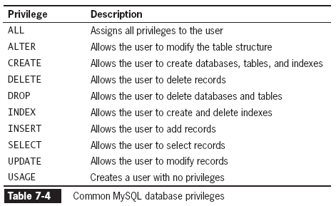
Modifying User Privileges

Slide 24
Granting Privileges
The syntax for the GRANT statement is:
GRANT privilege [(column)] [, privilege [(columns)]] ...
ON {table | * | *.* | database.*}
TO user [IDENTIFIED BY 'password'];
The GRANT statement creates the user account if it does not exist and assigns the specified privileges
If the user account already exists, the GRANT statement just updates the privileges

Slide 25
Revoking Privileges
The syntax for the REVOKE statement is:
REVOKE privilege [(column)] [, privilege [(columns)]] ...
ON {table | * | *.* | database.*}
FROM user;
The REVOKE ALL PRIVILEGES statement removes all privileges from a user account for a specified table or database
You must be logged in with the root account or have sufficient privileges to revoke privileges from another user account

Slide 26
Adding Records
Use the INSERT statement to add individual records to a table
The syntax for the INSERT statement is:
INSERT INTO table_name (column1, column2, …) VALUES(value1, value2, ...);
The values entered in the VALUES list must be in the same order in which you defined the table fields
Specify NULL in any fields for which you do not have a value

Slide 27
Adding Records
The LOAD DATA statement, with the full path and name of a local text file, is used to add multiple records to a table
LOAD DATA INFILE 'file_path' INTO TABLE table_name (column1, column2, …);
Each record in the text file must be placed on a separate line with a tab delimiter between each field

Slide 28
Adding Records
If the column list is omitted, the values on each line must be in the same order you defined the table fields
Use consecutive tabs with nothing between them to designate a column with no value
In MySQL Monitor, enter the following code at the mysql> prompt:
mysql> LOAD DATA INFILE ‘reps.txt' INTO TABLE REP;[ENTER]
The optional FIELDS TERMINATED BY clause of the LOAD DATA statement allows you to change the field separator to a character such as (~ or ,) instead of the default tab character

Slide 29
Retrieving Records
Use the SELECT statement to retrieve records from a table:
SELECT criteria FROM table_name;
Use the asterisk (*) wildcard with the SELECT statement to retrieve all fields from a table
To return multiple fields, separate field names with a comma

Slide 30
Using Aggregate Functions
Aggregate functions summarize data in record sets rather than display the individual records
The COUNT() function is unique in that
The wildcard (*) can be used as a function argument instead of a field name
The keyword DISTINCT can be used after the opening parentheses
The DISTINCT keyword can also be used with the SELECT statement to retrieve records with a unique value in the WHERE clause

Slide 31
Using Aggregate Functions
To retrieve aggregate values for groups of records, use the GROUP BY clause and include the fields that you use to group the records as part of the query
In MySQL Monitor, enter the following code at the mysql> prompt:
mysql> SELECT COUNT(*) as REP_COUNT, STATE
FROM REP GROUP BY STATE;[ENTER]

Slide 32
Filtering Query Results
The criteria portion of the SELECT statement determines which fields to retrieve from a table
You can also specify which records to return by using the WHERE keyword
In MySQL Monitor, enter the following code at the mysql> prompt:
mysql> SELECT * FROM REP WHERE STATE=‘NY';[ENTER]

Slide 33
Updating Records
To update records in a table, use the UPDATE statement
The syntax for the UPDATE statement is:
UPDATE table_name
SET column_name=value
WHERE condition;
The UPDATE keyword specifies the name of the table to update
The SET keyword specifies the value to assign to the fields in the records that match the condition in the WHERE keyword

Slide 34
Deleting Records
Use the DELETE statement to delete records in a table
The syntax for the DELETE statement is:
DELETE FROM table_name
WHERE condition;
The DELETE statement deletes all records that match the condition
To delete all the records in a table, leave off the WHERE keyword

Slide 35
Summary
MySQL Monitor is a command-line program that you use to manipulate MySQL databases
To work with a database, you must first select it by executing the USE DATEBASE statement
You use the CREATE DATABASE statement to create a new database
To delete a database, you execute the DROP DATABASE statement, which removes all tables from the database and deletes the database itself
To keep your database from growing too large, you should choose the smallest data type possible for each field
To create a table, you use the CREATE TABLE statement, which specifies the table and column names and the data type for each column
To modify a table, you use the ALTER TABLE statement, which specifies the table being changed and the change to make
To delete a table, you execute the DROP TABLE statement, which removes all data and the table definition
You use a GRANT statement to create user accounts and assign privileges, which refer to the operations that a user can perform with a database
You use the REVOKE statement to take away privileges from an existing user account for a specified table or database
To add multiple records to a database, you use the LOAD DATA statement with a local text file that contains the records you want to add

Slide 36
Exercise
Load the TAL Distributors database tables in MySQL with sample data.
What did you have to change in MySQL SQL statements, compared to Oracle?

Slide 37
Homework
Configure the MySQL Workbench to connect to your local MySQL database.
Create the Colonial Adventure Tours database, tables and sample data using MySQL Workbench.

